Slide 1
Registry Spy OpenEDR

Slide 2



OUR TEAM
Nguyễn Bình Thục Trâm
Võ Anh Kiệt
Nguyễn Bùi
Kim Ngân
20520815
20520605
20520648

Slide 3
Table of contents
01
02
Registry Spy
EDR - OpenEDR

Slide 4
01
Registry Spy

Slide 5

Registry Spy
Registry Spy is a free, open-source cross-platform Windows Registry viewer. It is a fast, modern, and versatile explorer for raw registry files.

Slide 6
Requirement installation
(-) Python >= 3.8
Python is a high-level, general-purpose programming language. Its design philosophy emphasizes code readability with the use of significant indentation via the off-side rule.

Slide 7
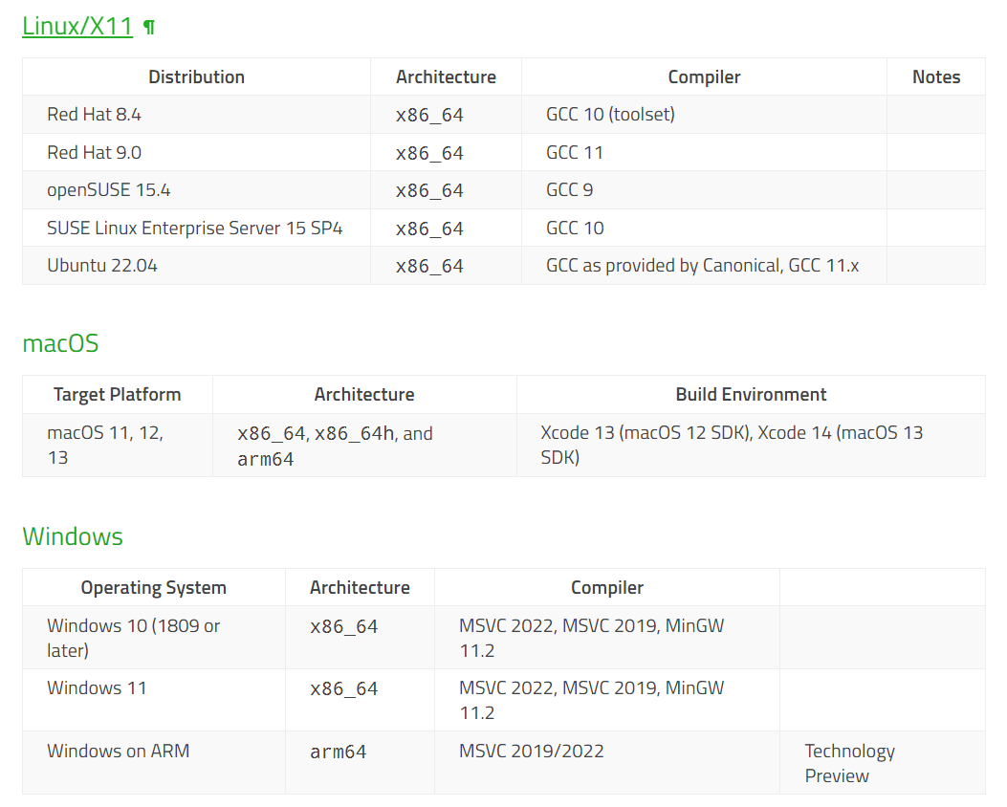
Requirement installation
(-) Operation System

Slide 8
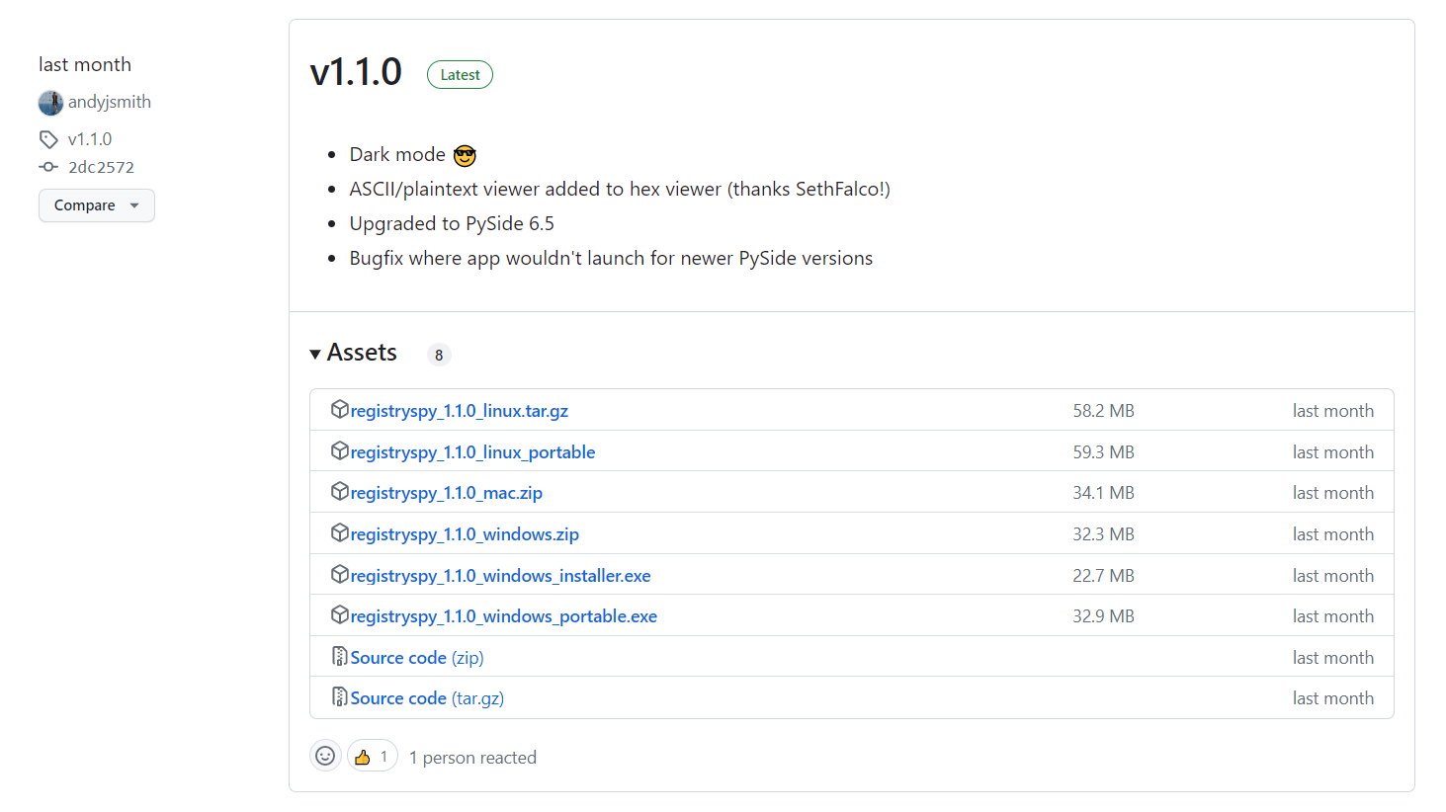
Installation
(-) Version

Slide 9
Installation
(-) Pip pip install registryspy registryspy
(-) Manual pip install –r requirements.txt
python setup.py install registryspy
(-) Standalone pip install –r requirements.txt
python registryspy.py

Slide 10
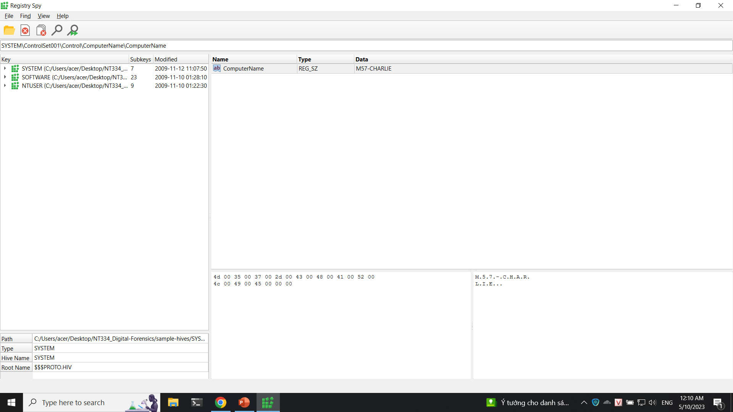
Implemetation

Slide 11
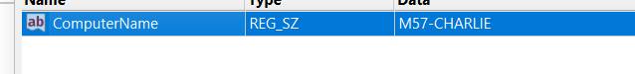
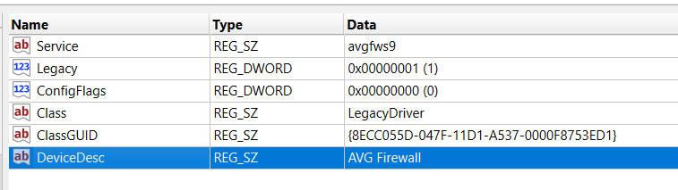
Computer and Firewall

Slide 12
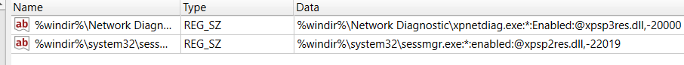
List application in Firewall list

Slide 13
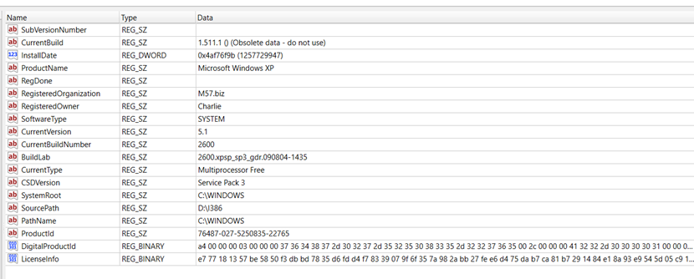
Operation System

Slide 14
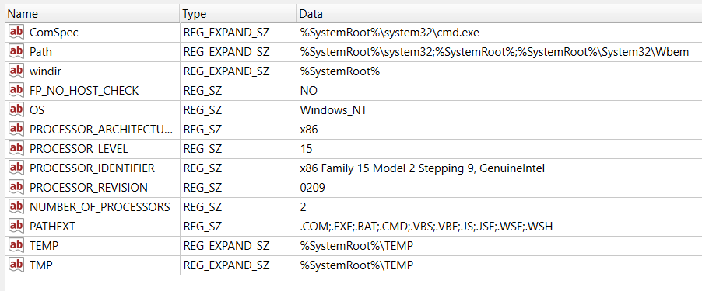
Enviroment

Slide 15
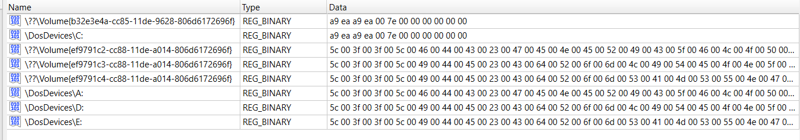
Mount Device

Slide 16
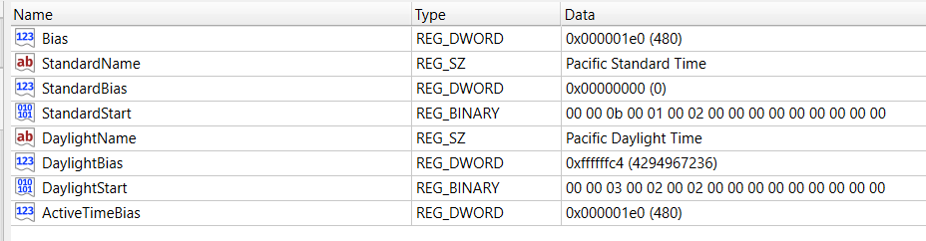
Time Zone

Slide 17
Network card

Slide 18
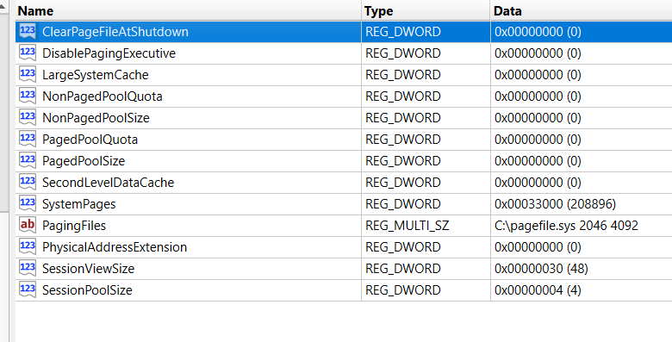
Memory management

Slide 19
02
EDR – Endpoint Detect Respone OpenEDR

Slide 20

OpenEDR
Open EDR is a sophisticated, free, open-source endpoint detection and response solution. It provides analytic detection with Mitre ATT&CK visibility for event correlation and root cause analysis of adversarial threat activity and behaviors in real time. This world-class endpoint telemetry platform is available to all cyber-security professionals, and every sized organization, to defend against threat actors and cyber criminals.

Slide 21
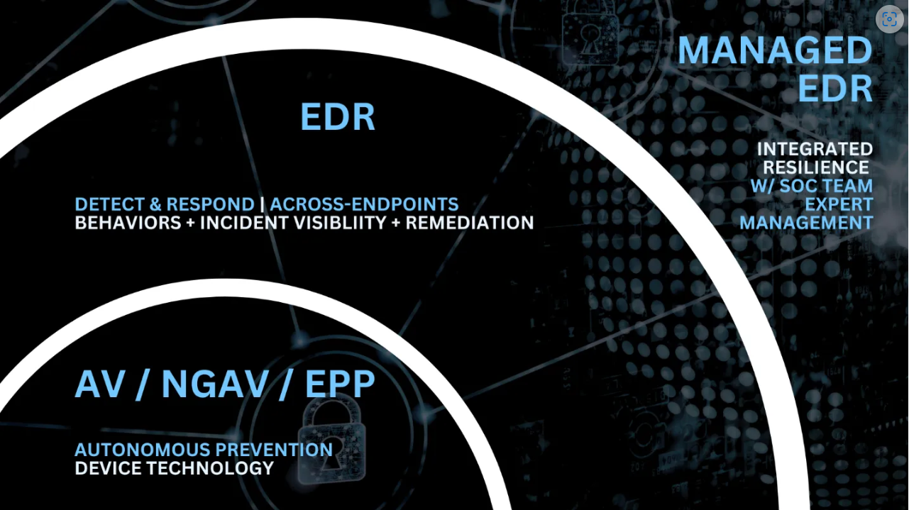
OpenEDR

Slide 22
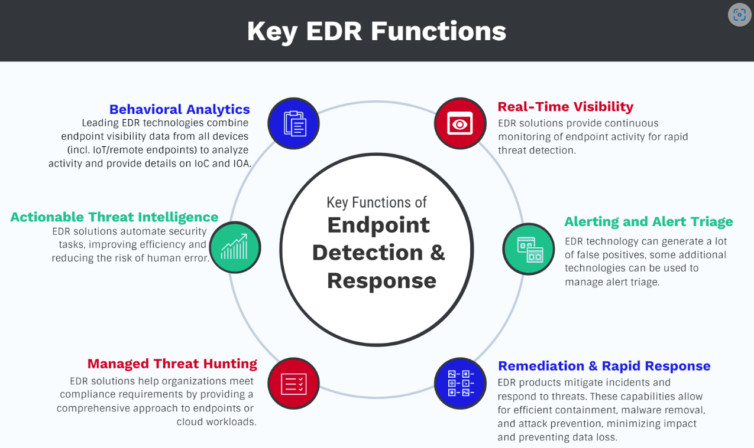
OpenEDR

Slide 23
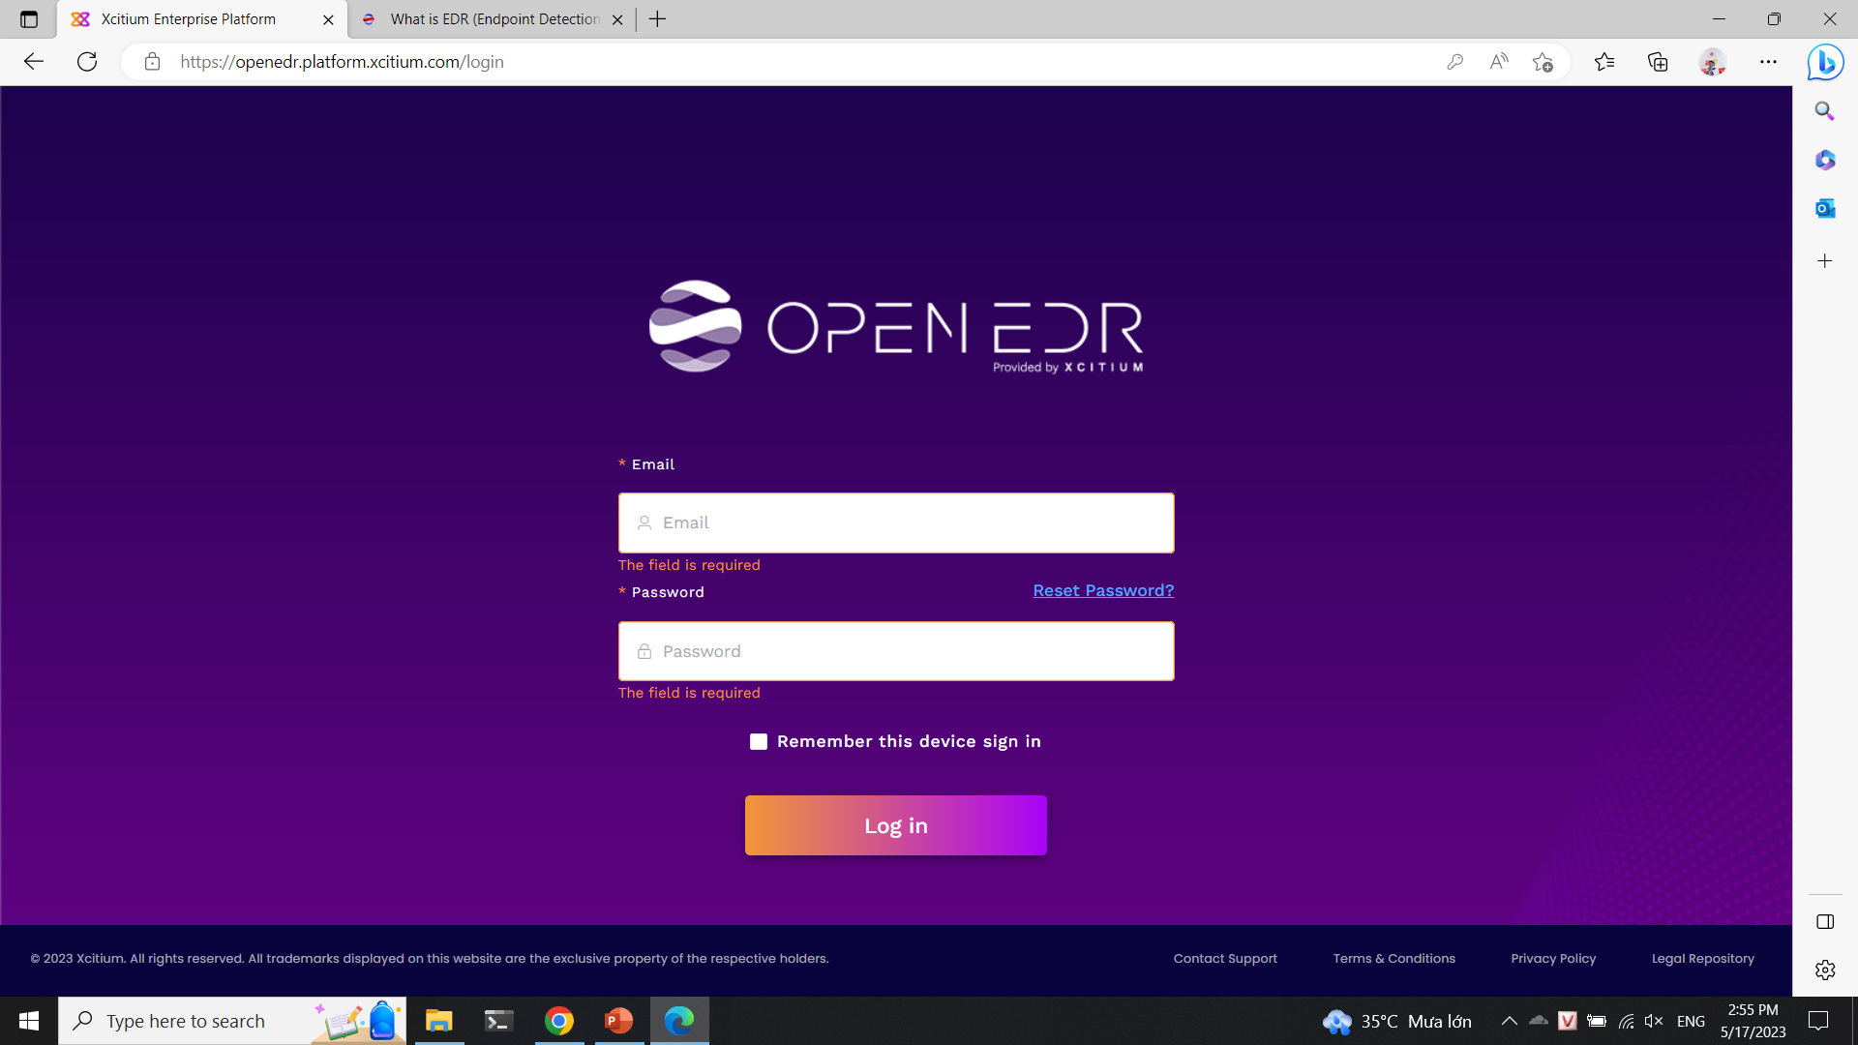
Installation

Slide 24
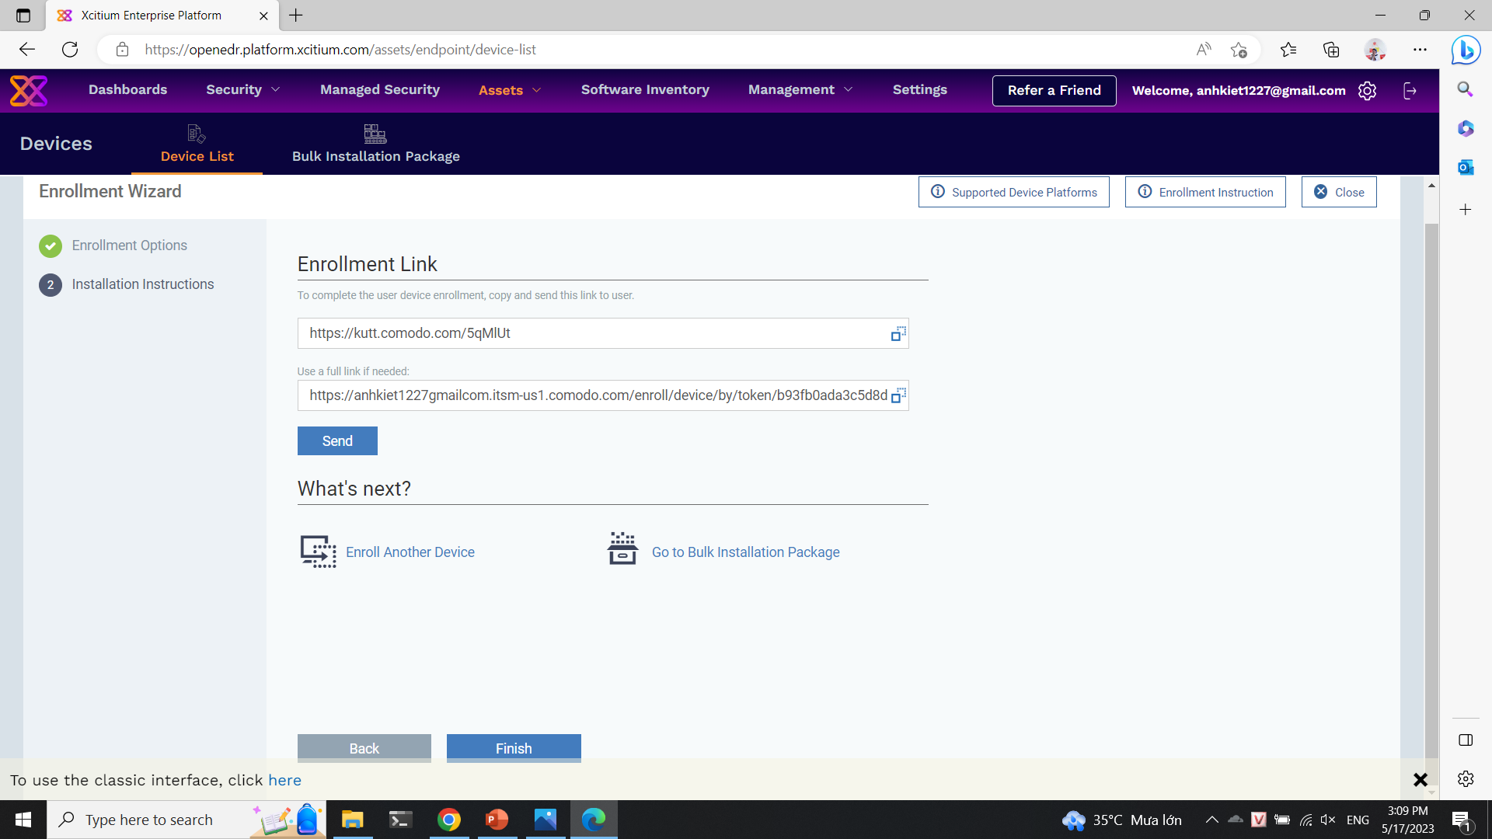
Installation Agent

Slide 25
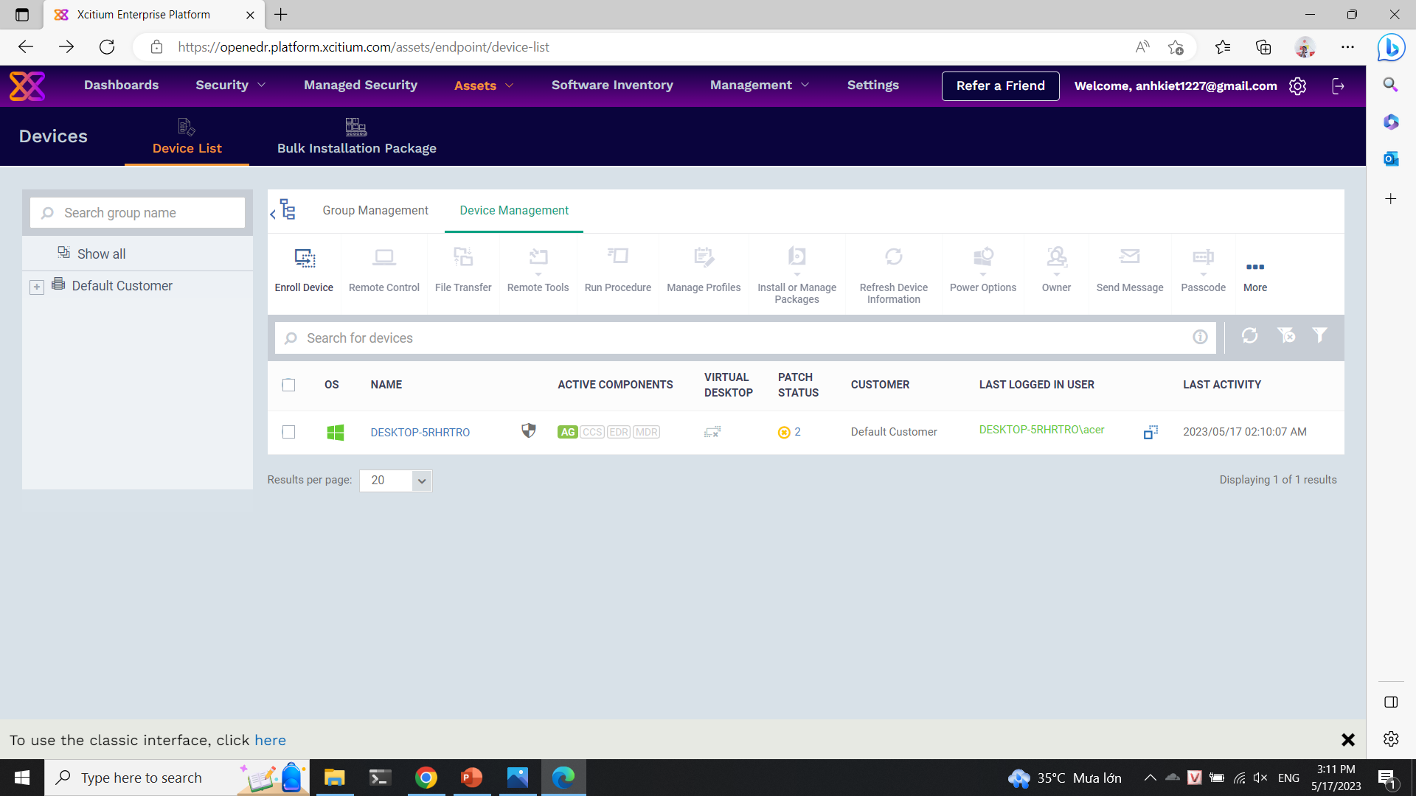
Installation Agent

Slide 26
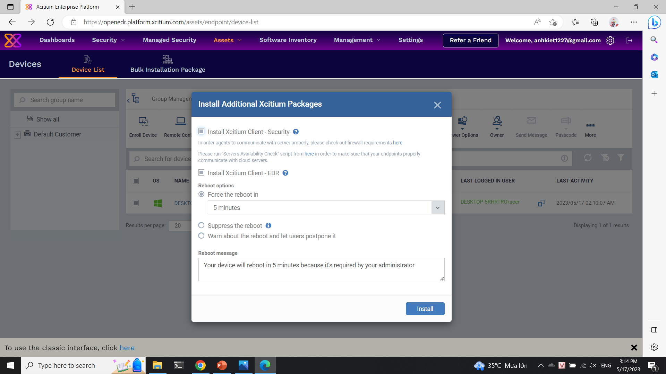
Installation Packages

Slide 27
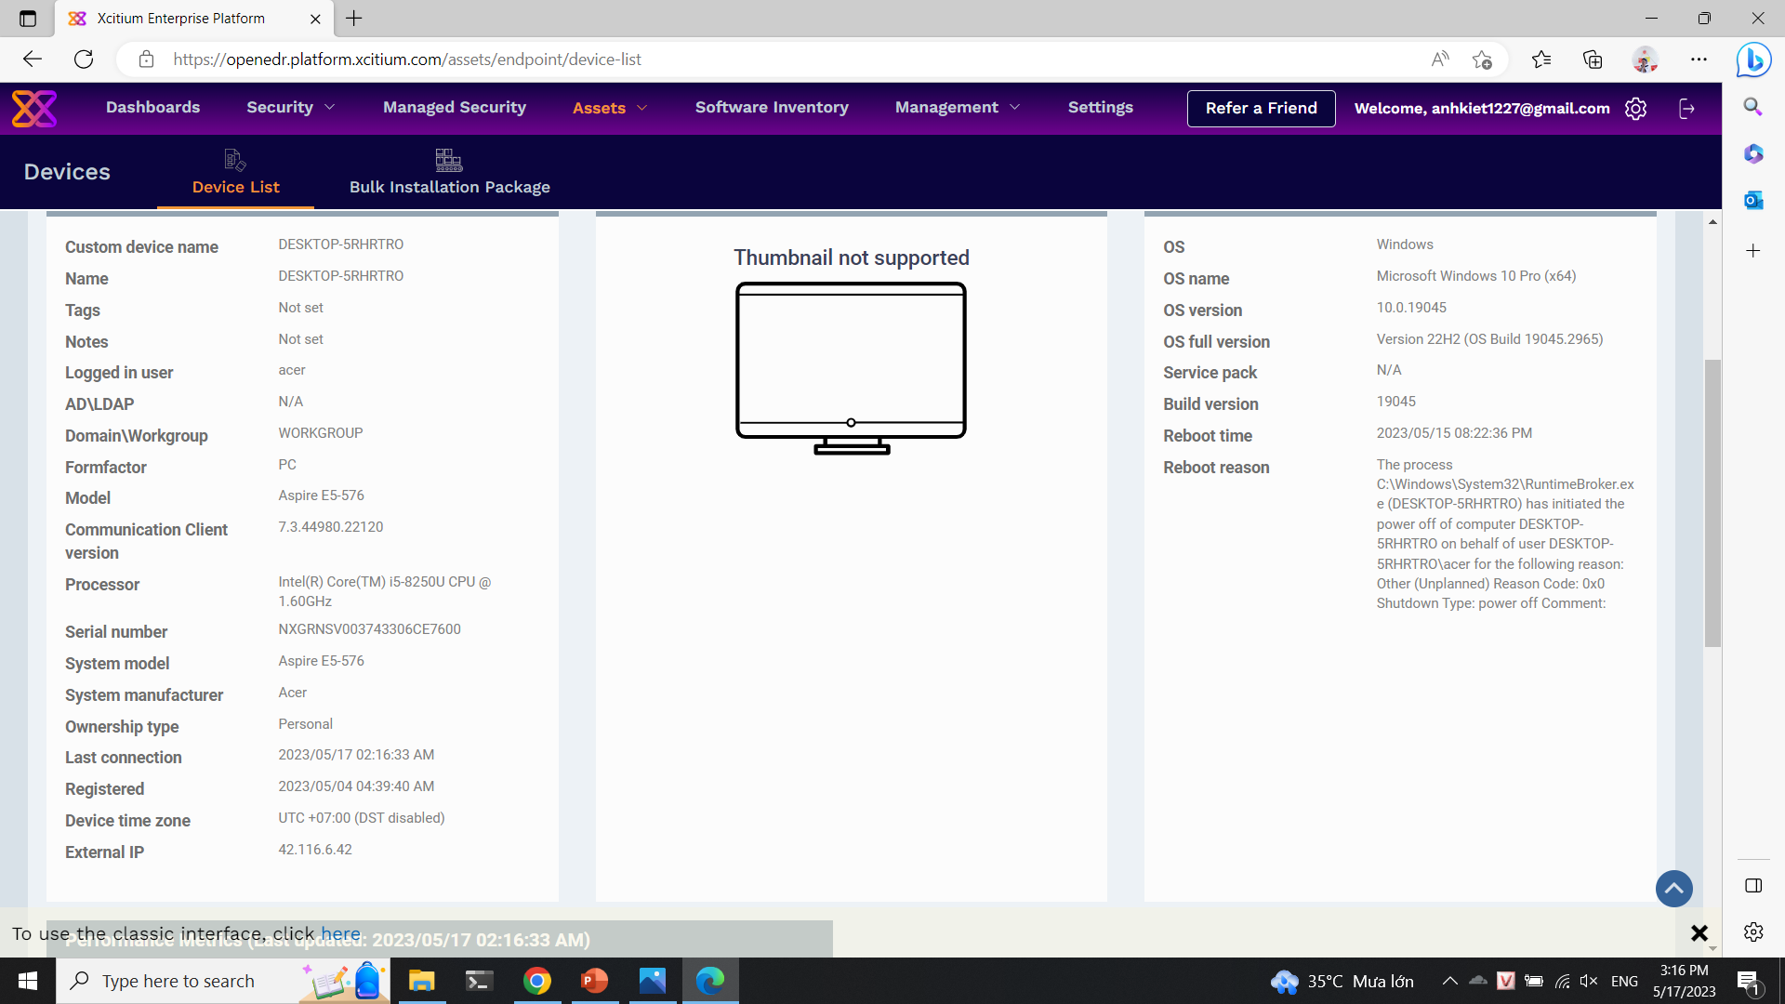
Tool scanning

Slide 28
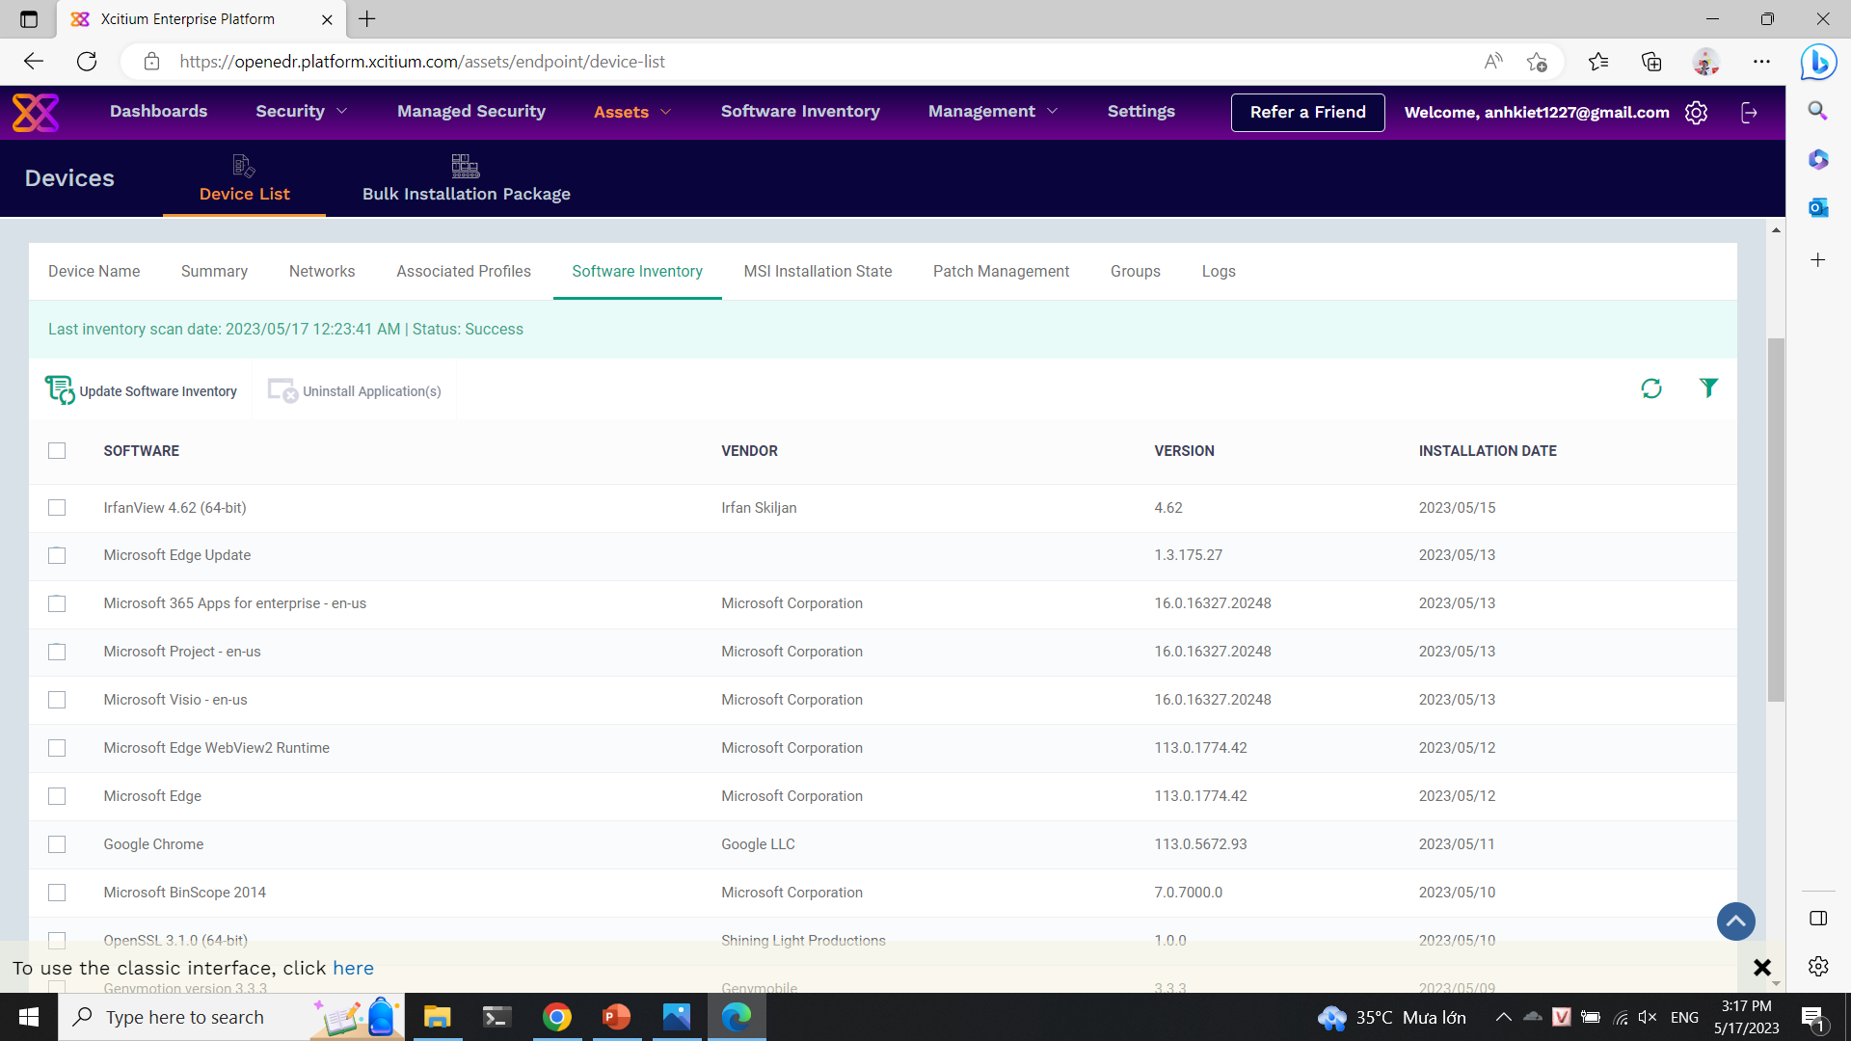
Tool scanning

Slide 29
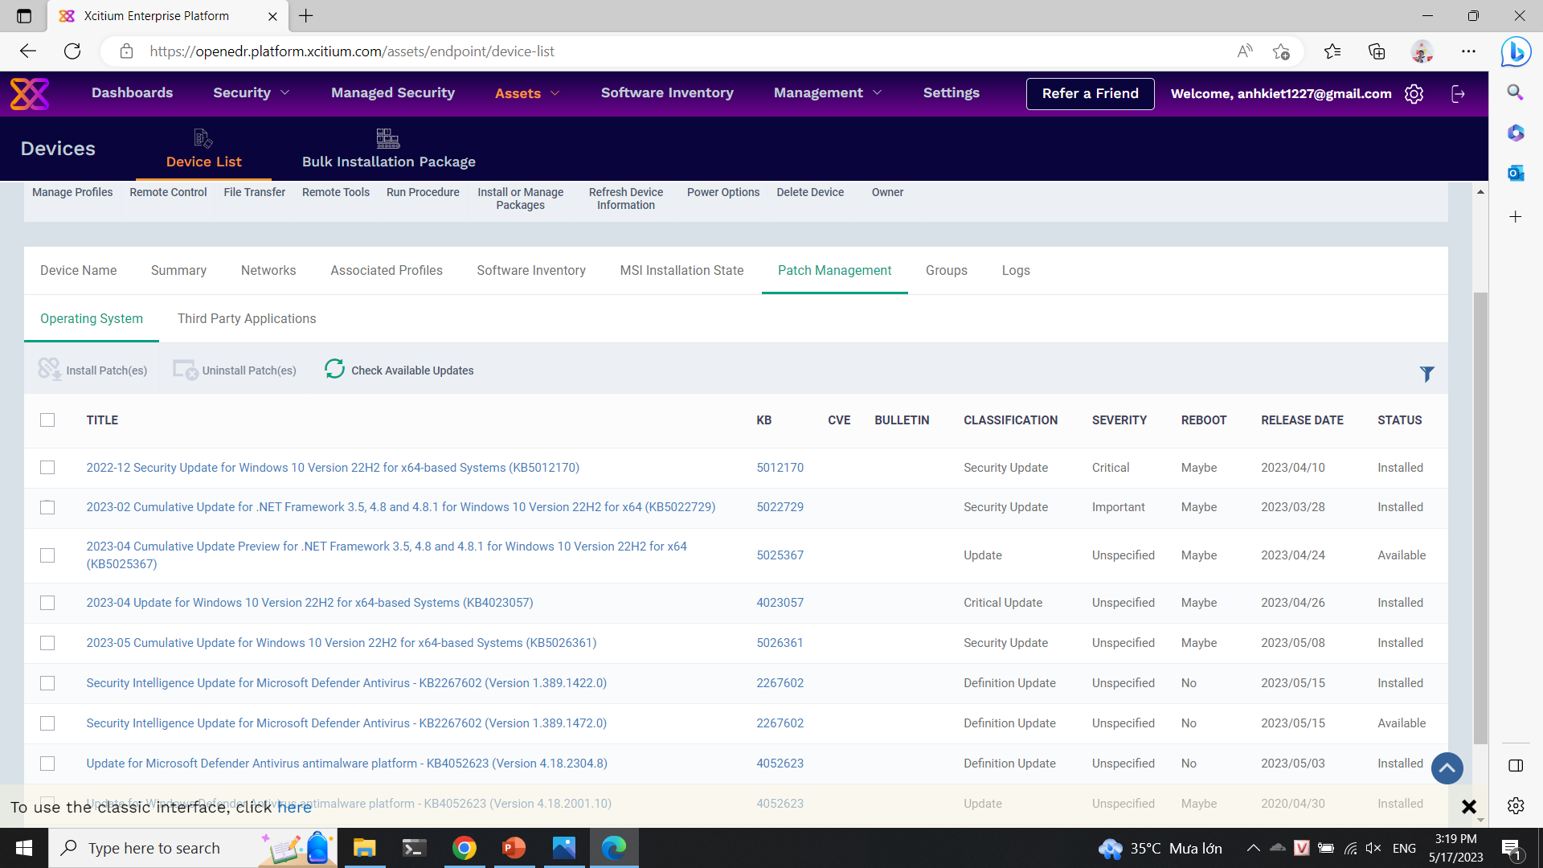
Tool scanning

Slide 30
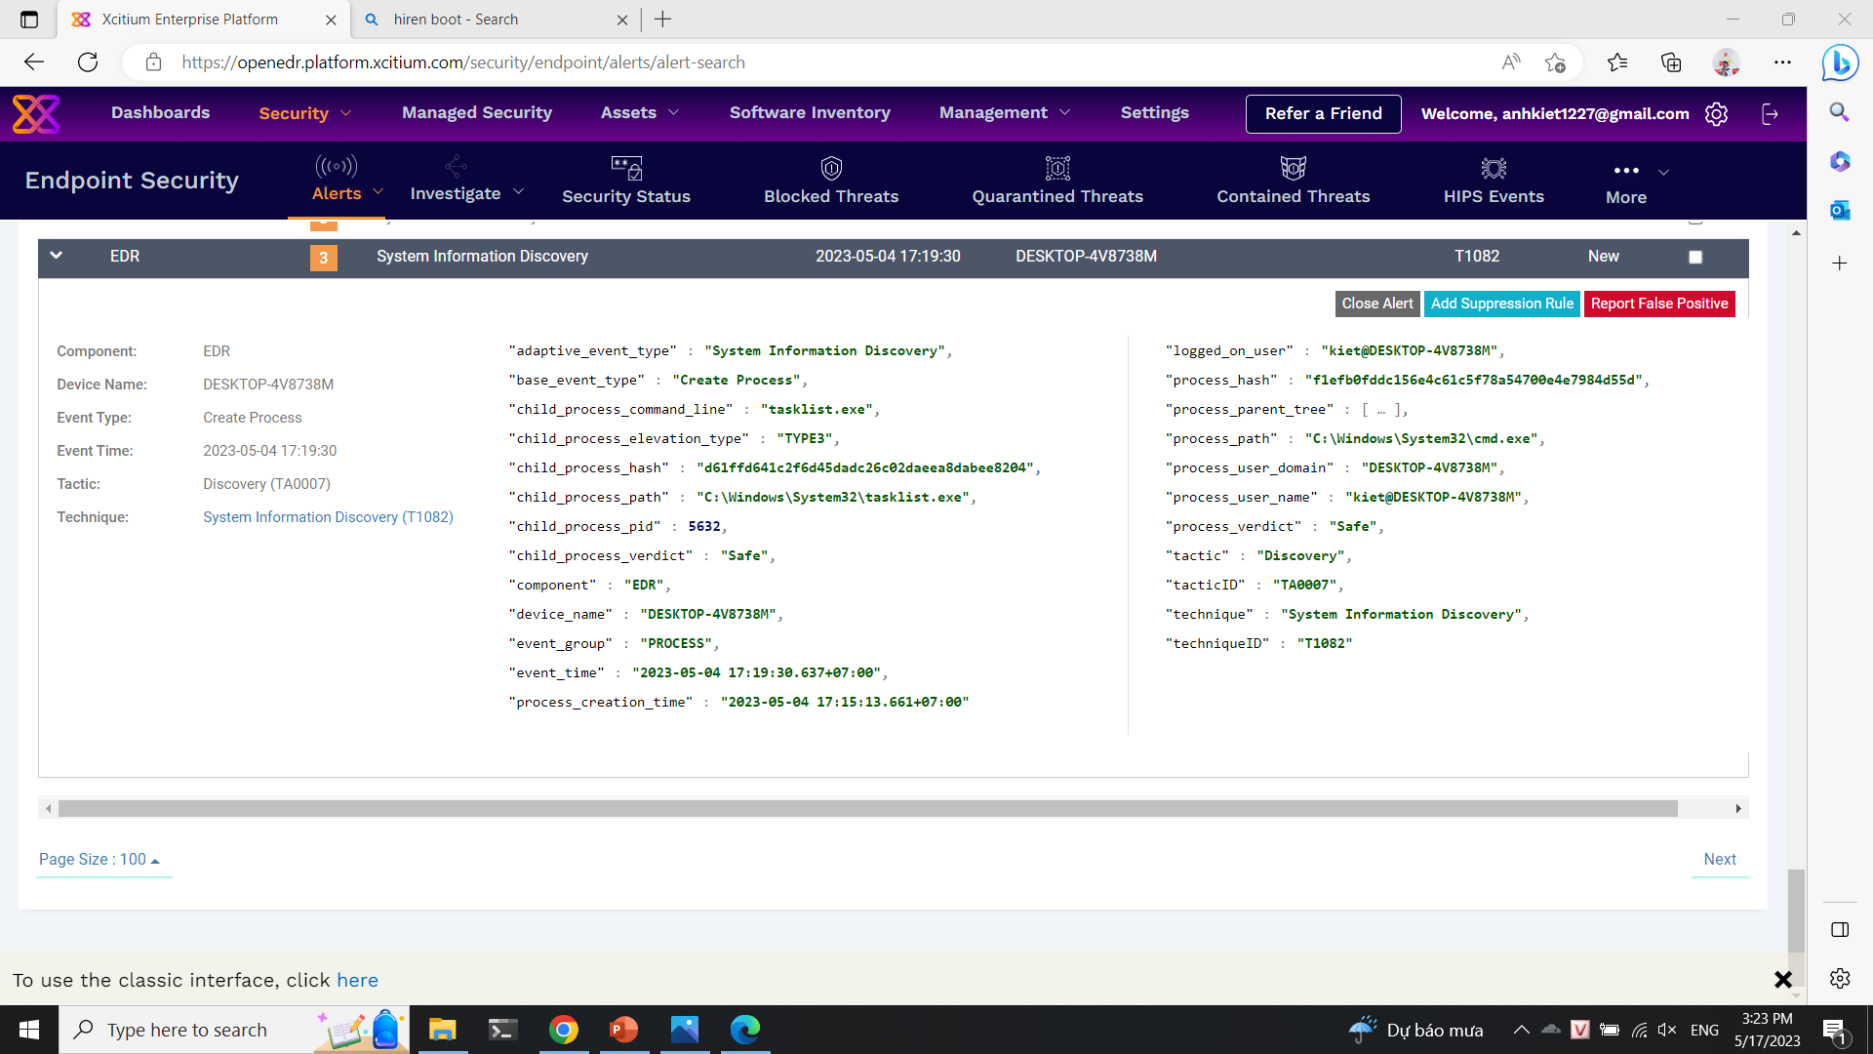
Tool scanning

Slide 31
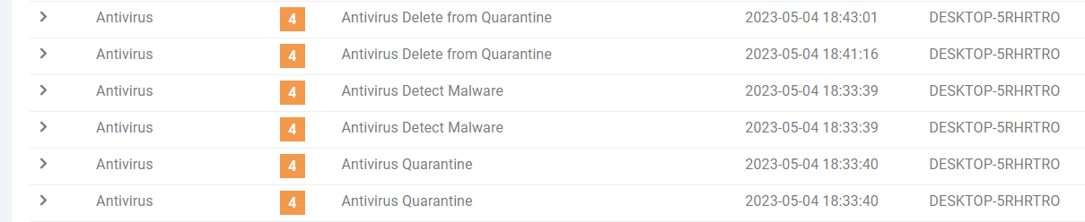
Malware

Slide 32
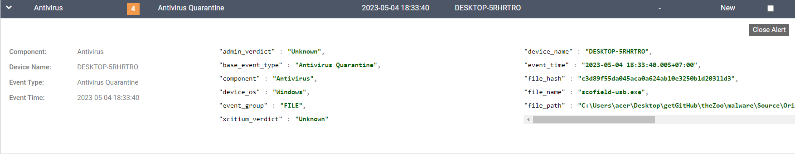
Malware

Slide 33
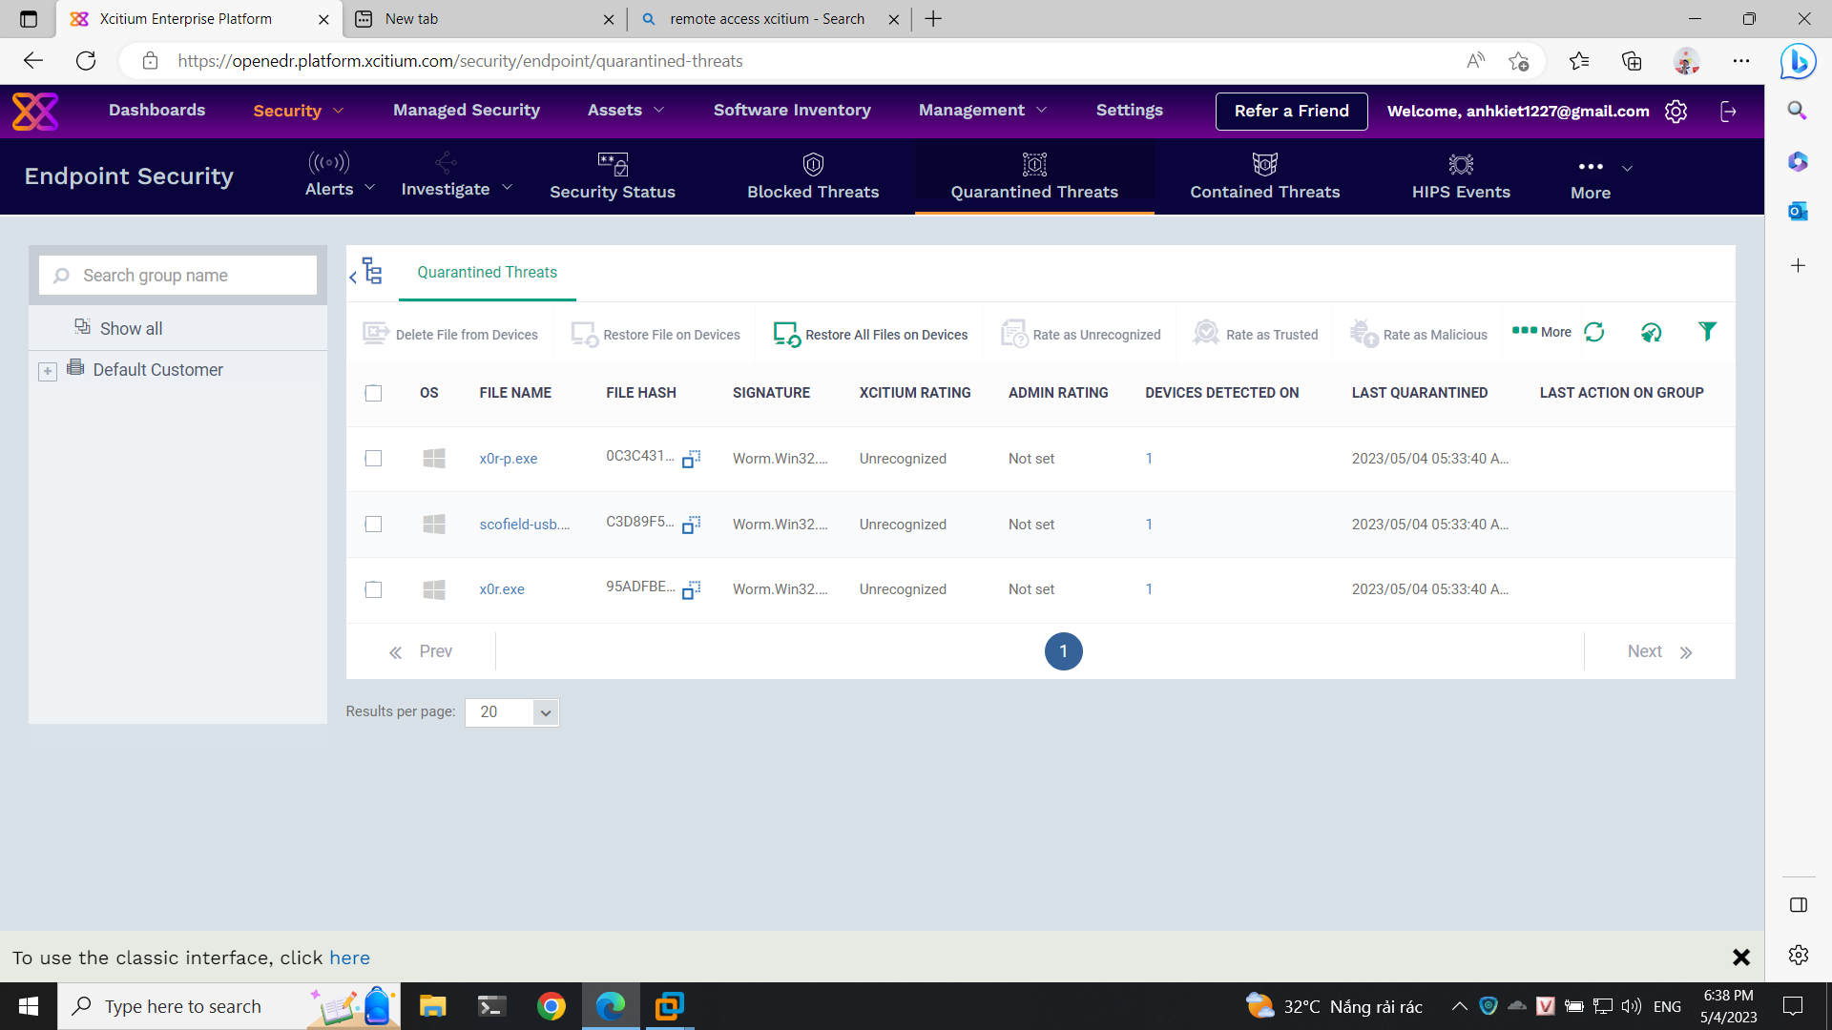
Malware

Slide 34
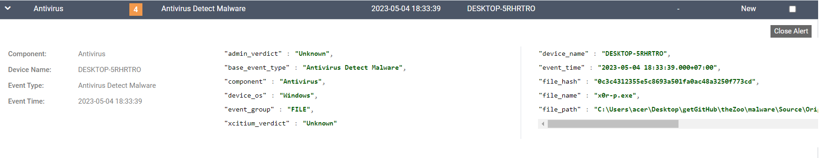
Malware

Slide 35
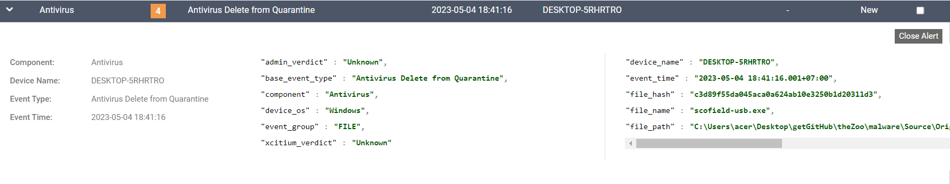
Malware

Slide 36
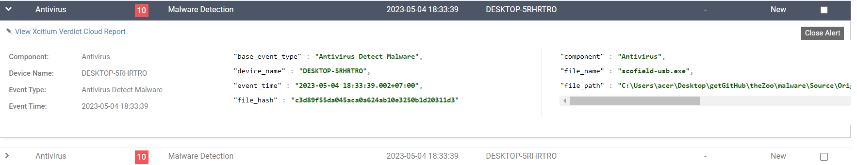
Malware

Slide 37
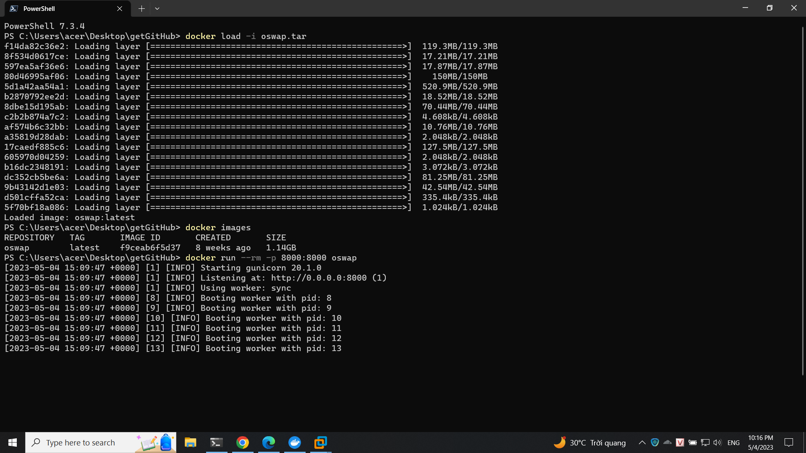
PyGoat – Top 10 OWASP

Slide 38
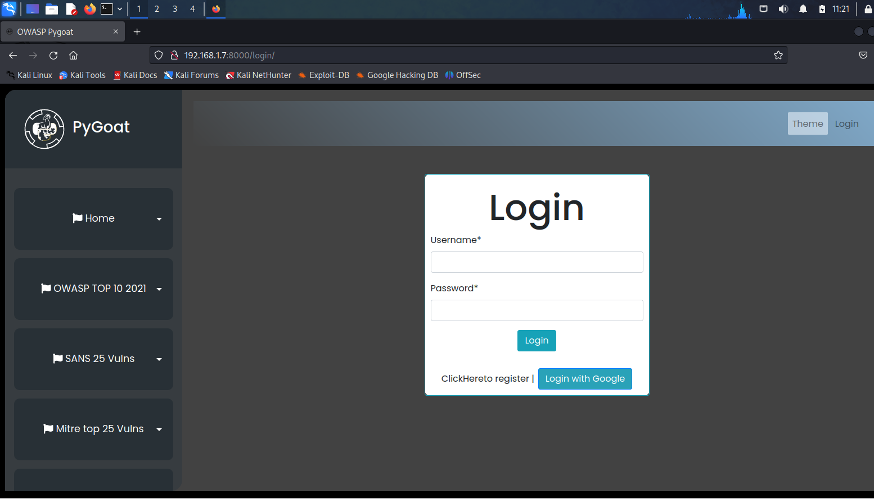
PyGoat – Top 10 OWASP

Slide 39
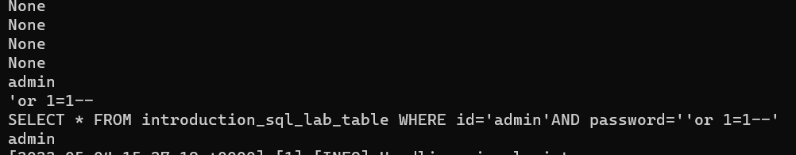
PyGoat – Top 10 OWASP
No announcement on OpenEDR

Slide 40
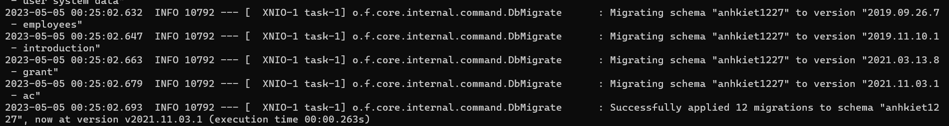
WebGoat – Top 10 OWASP
No announcement on OpenEDR

Slide 41
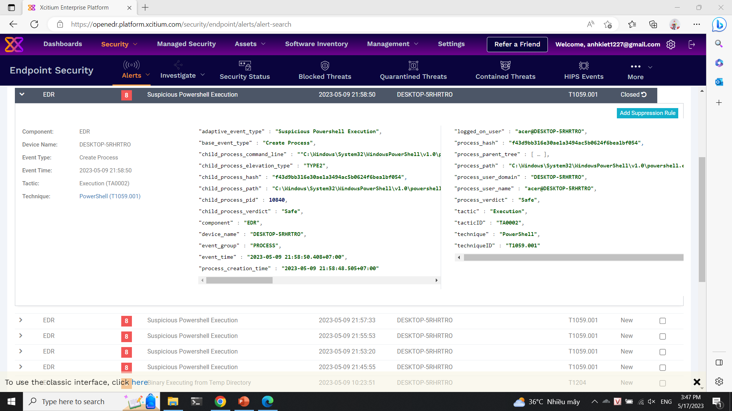
Weakness

Slide 42
Resources
What is EDR (Endpoint Detection & Response)? Open source EDR® (openedr.com)
GitHub - andyjsmith/Registry-Spy: Cross-platform registry browser for raw Windows registry files

Slide 43
Thanks!
Any questions?
Please, keep this slide as attribution

